Slide 1
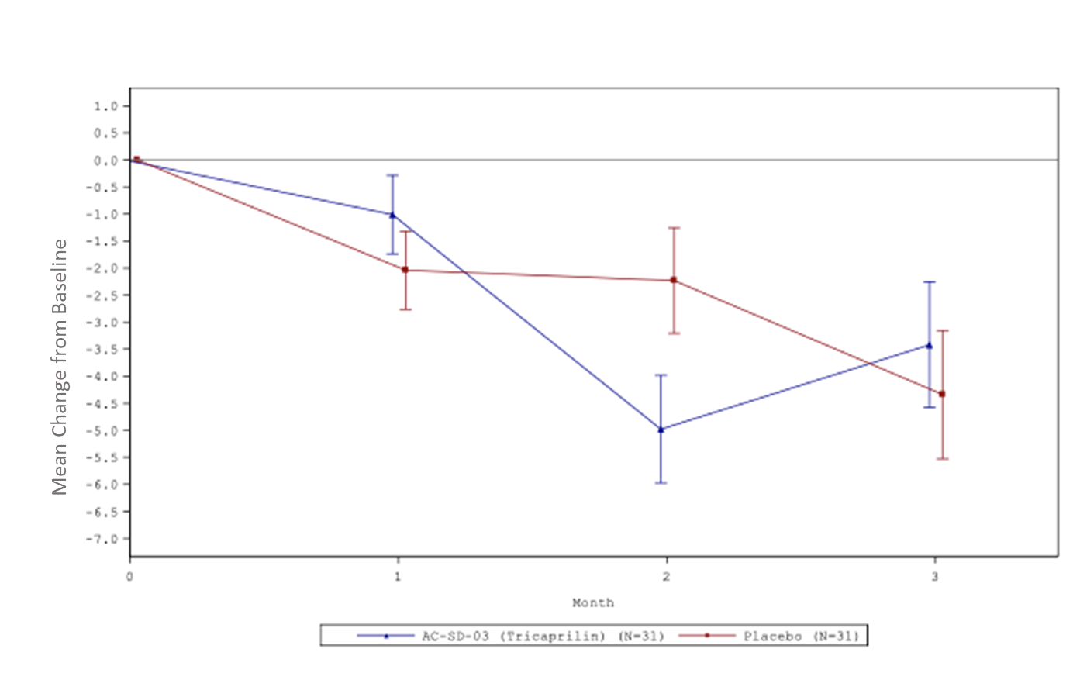
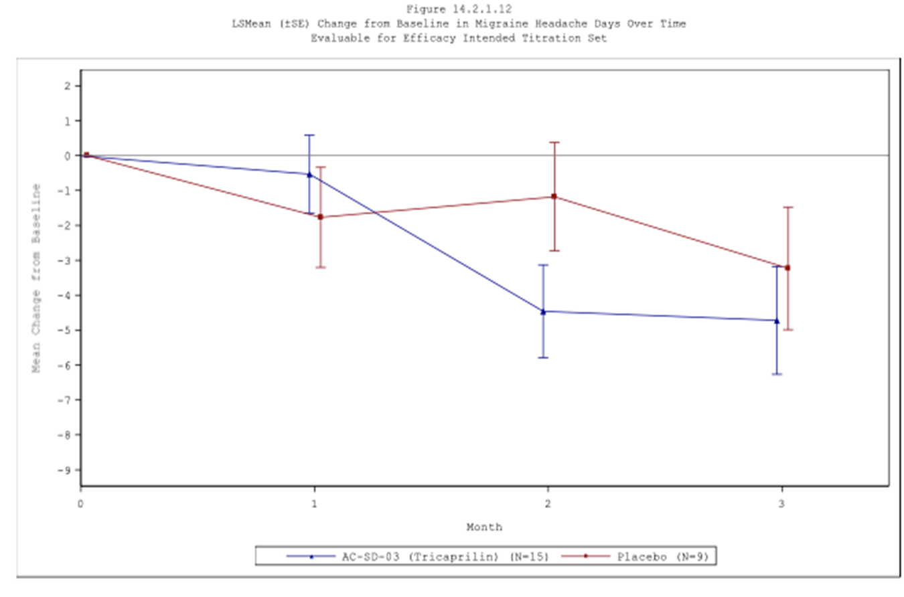
Metabolic Mechanism in Migraine: Tricaprilin, a Ketogenic Agent
Lilian Chow*, Julia Presanis DPhil*, Nikki McIntyre*, Samuel Henderson PhD**, Marc Cantillon MD**
ABSTRACT
BACKGROUND Induction of ketosis as a mechanism for correcting metabolic defects in migraineurs.
DESIGN Initially designed as a two-part study, Part 1 for accurate sample size estimation, Part 2 for Proof of Concept
DESIGN Inclusion and Exclusion Criteria Included Frequent Migraineurs who had Tried and Failed at Least 1 Prophylactic
Background: Increasing evidence suggests that migraine headaches have an underlying metabolic etiology. In particular, the induction of ketosis has been implicated in correcting metabolic defects found in migraineurs. Tricaprilin is a ketogenic agent that can induce ketosis without the need for changes to diet.
Cerecin has developed CER-001 (tricaprilin) a pure C8 medium chain triglyceride (MCT), to safely induce ketosis
Key Inclusion Criteria
Key Exclusion Criteria
Design: This was a double-blind, randomized, placebo-controlled, 3-month study of up to 60g/day tricaprilin. The study was designed to include two parts; Part 1 a small pilot study for accurate sample size calculation; and Part 2 a fully powered proof-of-concept study. The primary endpoint was the change from baseline in the number of migraine headache days (MHDs) during month 3. Participants were to have 4-24 MHDs in the baseline period. The study was registered on clinicaltrials.gov (NCT04437199).
Efficacy has been shown in two Phase 2 studies in mild to moderate Alzheimer’s disease [1,2]
Due to the tolerability of the AC-SD-03 formulation, only Part 1 of the study was conducted. Part 2 will be conducted as a separate study with a new formulation of CER-001.
Cerecin is also exploring the use of CER-001 in migraine, where reports of efficacy with the ketogenic diet have been reported in case studies and controlled trials [3-8]
AC-SD-03: titration to 20g tricaprilin BID, orally
Subject had migraine diagnosed according to ICHD-3 beta criteria, age at time of onset <50 years
Subjects had 4-24 Migraine Headache Days in the baseline measurement period
Use of one allowed migraine prophylactic permitted
Subjects must have trialed and failed at least 1 (and up to 4) categories of prophylactic migraine medications
Subjects had at least 80% compliance with headache eDiary entries in the baseline measurement period
History of hemiplegic migraine, cluster headache, or other trigeminal autonomic cephalgia
Presence of a chronic pain syndrome (other than migraine), such as fibromyalgia
History of a major psychiatric disorder or current moderately severe depression
Use of barbiturates or opioids for migraine acute treatment ≥4 days per month on average
Use in the last 3 months of CGRP agents, Botox, TENS, cranial nerve blocks, trigger-point injections, acupuncture specifically for migraine
Use in the last 2 weeks of SGLT2 inhibitors
Current use or use within the last 3 months of MCT-containing products or a ketogenic diet, low-carb diet, intermittent fasting
The primary pathogenic mechanism for migraine is not definitively elucidated, however there is evidence to suggest involvement of brain energy metabolism abnormalities. It has been postulated that migraine is a response to cerebral energy deficiency or oxidative stress levels and that the attack itself helps to restore brain energy homeostasis and reduces harmful oxidative stress levels [9]
4-week baseline
measurement period
N = 83
Part 2 of the study was to have the same study design as Part 1, with a sample size calculation based on the standard deviation observed in Part 1 of the study.
Results: Due to formulation tolerability issues, Part 2 was not conducted. Results from Part 1 (non-powered pilot phase) are presented. A total of 81 participants were randomized and dosed in the study (n=40 tricaprilin, n=41 placebo), and 61 participants (31 per arm) had evaluable efficacy data. For Part 1, there was no meaningful difference in the primary endpoint between treatment arms during Month 3. During Month 2, a mean improvement of -2.75 days was observed, in favour of tricaprilin. In a pre-specified per-protocol analysis set there was a difference of -1.49 days to placebo at Month 3. The withdrawal rate was 45.0% and 53.7% (tricaprilin; placebo). Treatment-emergent adverse events, majority gastrointestinal, occurred in both active and placebo arms (90.0%, 82.9%).
Placebo
Ketosis is thought to restore brain electrical activity and metabolism, and help counteract neuroinflammation in migraine, although the precise mechanism is unclear [10]
Double – blind (12 weeks)
1 week safety follow-up
Key Protocol Amendments:
Original protocol included titration up to a max daily dose of 60 g. Protocol version 3 onwards used a maximum daily dose of 40 g
Original protocol included a 2-week titration. Protocol version 3 onwards used a titration period of 3 weeks.
Key Protocol Deviations:
Subjects who did not have intended disease (migraine) – 0 in the study
Subjects who did not have intended indication (4-24 Migraine Headache Days) – 5 in the study
Conclusion: Results of the pilot suggest directional promise over 2-3 months for tricaprilin, and a new formulation will be used for larger, fully-powered Phase 2/3 studies.
The study was designed according to the principles outlined International Headache Society (IHS) Guidelines for Controlled Trials of Drugs in Migraine [11]
DESIGN Statistical Analysis
RESULTS
Patient Disposition: Active and placebo patient groups were well-balanced. The Per Protocol set (EEITS) was quite small n = 24
RESULTS
Baseline Characteristics: Participants were generally balanced between treatment arms
RESULTS
Efficacy Analysis: Efficacy Signal at Month 2 (EES) and in the Per Protocol Set (EEITS; Month 2 and Month 3), small participant numbers limit the ability to draw conclusions
Sample Size
Analysis Sets
Screened (n=164)
Characteristics | Statistics | CER-001 (N=40) | Placebo (N=41) | Total (N=81)
Age | n | 40 | 41 | 81
 | Mean | 44.8 | 46.9 | 45.8
 | SD | 12.21 | 11.50 | 11.83
 | Median | 46.0 | 49.0 | 48.0
 | Min, Max | 18, 70 | 22, 66 | 18, 70
Sex
Female | n (%) | 30 (75.0%) | 35 (85.4%) | 65 (80.2%)
Male | n (%) | 10 (25.0%) | 6 (14.6%) | 16 (19.8%)
Race
White | n (%) | 38 ( 95.0%) | 37 ( 90.2%) | 73 ( 90.1%)
Indian/ Indian sub continent | n (%) | 0 ( 0.0%) | 1 ( 2.4%) | 1 ( 1.2%)
Chinese | n (%) | 1 ( 2.5%) | 0 ( 0.0%) | 1 ( 1.2%)
Japanese | n (%) | 1 ( 2.5%) | 0 ( 0.0%) | 1 ( 1.2%)
Aboriginal Australian | n (%) | 0 ( 0.0%) | 3 ( 7.3%) | 3 ( 3.7%)
Other | n (%) | 0 ( 0.0%) | 1 ( 2.4%) | 1 ( 1.2%)
Age, Height and BMI were well-balanced between treatment groups
A slight imbalance was observed between arms with respect to sex:
The CER-001 arm contained more males (25%) than the placebo arm (14.6%)
There was also a slight imbalance in weight between arms, probably a consequence of the slight sex imbalance
BMI was balanced however
Statistical Analysis of the Change from Baseline in Migraine Headache Days (MHDs ± SE) Over Time
Since there was no efficacy data for tricaprilin in migraine prior to this study, the study was originally designed in two parts
Part 1 was a pilot study, designed to provide an estimate of the between-subject SD in this population prior to embarking to Part 2, which was designed to demonstrate proof of concept
Under the original design, a sample size re-estimation would have been performed at the end of Part 1, using the observed between-subject SD from Part 1, however Part 2 was not conducted due to the tolerability of the AC-SD-03 formulation
Part 1 was therefore not formally powered for the primary endpoint
Full Analysis Set (FAS): All randomised subjects who received at least one dose of IMP, analysed in accordance with intended treatment arm
Safety Set (SAF): Same as above, but analysed according to treatment received
Evaluable for Efficacy Set (EES): Subset of the FAS with at least 14/28 diary entries in any post-baseline month
Intended Titration Evaluable for Efficacy Set (EEITS): A per-protocol sensitivity analysis set for Protocol Amendment 3. The subset of the EES who received a 21-day titration, and achieved a maximum daily dose no higher than 40g of Tricaprilin/Placebo between days 16 and 21
Randomised Set (n=83)
81 Screen failures
1 subject not dosed
Randomised Set
Tricaprilin (n=41)
Randomised Set
Placebo (n=42)
1 subject not dosed
9 excluded due to <14/28 post-baseline diary entries
Full Analysis Set/Safety Set
Tricaprilin (n=40))
Full Analysis Set/Safety Set
Placebo (n=41))
10 excluded due to <14/28 post-baseline diary entries
Sample Size
16 excluded due to <21 day titration and/or <40 g maximum daily dose
Evaluable for Efficacy Set Tricaprilin (n=31)
Evaluable for Efficacy Set
Placebo (n=31)
22 excluded due to <21 day titration and/or <40 g maximum daily dose
Primary endpoint: change from baseline in migraine headache days (MHDs) in Month 3
The effect of tricaprilin on the change in the number of MHDs per month was estimated from a mixed effects repeated measures model fitting the change from Baseline in MHDs as the response variable, treatment (tricaprilin or placebo), time (month 1, month 2, or month 3) and a treatment by time interaction term as fixed effects, and as well as the continuous fixed covariate of baseline number of MHD. An unstructured covariance matrix was used.
Primary Endpoint: Change from Baseline in MHDs in Month 3, Evaluable for Efficacy Set (EES);
CER-001: -3.4 MHDs, placebo: -4.3 MHDs, p = 0.586
Change from Baseline in MHDs in Month 3, Per-Protocol Evaluable for Efficacy Intended Titration Set (EEITS); CER-001: -4.7 MHDs, placebo: -3.2 MHDs
Intended Titration Evaluable for Efficacy Set Tricaprilin (n=15)
Intended Titration Evaluable for Efficacy Set Placebo (n=9)
RESULTS
RESULTS
DISCUSSION
CONCLUSIONS
REFERENCES
Efficacy Analysis: Post-hoc exploration of the data
Safety and Tolerability
Discussion of results
No significant safety issues were identified during the study, but neither the AC-SD-03 formulation of CER-001 nor the matching placebo appeared well tolerated
Although the primary endpoint showed no difference of tricaprilin to placebo on the primary endpoint (change from baseline in migraine headache days [MHD] in Month 3 in the EES), results from Month 2 (EES, EEITS), and Month 3 (EEITS) indicate an efficacy signal
The similar incidence of causally-related TEAEs, and the withdrawal rate in both treatment arms indicate poor tolerability of the formulation rather than CER-001
Results of the pilot suggest directional promise over 2-3 months for oral tricaprilin, and a new formulation will be used for larger, fully-powered Phase 2/3 studies
Reger MA, Henderson ST, et al. Neurobiol of Aging. 2004; 25: 311–314.
Henderson ST, Vogel JL, et al. Study of the ketogenic agent AC-1202 in mild to moderate Alzheimer's disease: A randomized, double-blind, placebo-controlled, multicenter trial. Nutr Metab. 2009; 6(1): 31.
Strahlman, R.S. Can ketosis help migraine sufferers? A case report. Headache. 2006; 46: 182.
Maggioni, F.; Margoni, M.; Zanchin, G. Ketogenic diet in migraine treatment: A brief but ancient history. Cephalalgia Int. J. Headache. 2011; 31: 1150–1151.
Di Lorenzo, C., Currà, A., Sirianni, G., et al. Diet transiently improves migraine in two twin sisters: Possible role of ketogenesis? Funct. Neurol. 2013; 28: 305–308.
Di Lorenzo, C., Coppola, G., Sirianni, G., et al. Migraine improvement during short lasting ketogenesis: a proof-of-concept study. Eur J Neurol. 2015; 22: 170-177.
Di Lorenzo, C., Coppola, G., Bracaglia, M., et al. Cortical functional correlates of responsiveness to short-lasting preventive intervention with ketogenic diet in migraine: A multimodal evoked potentials study. J. Headache Pain 2016; 17: 58.
Di Lorenzo C, Pinto A, Ienca R, et al. A Randomized Double-Blind, Cross-Over Trial of very Low-Calorie Diet in Overweight Migraine Patients: A Possible Role for Ketones? Nutrients. 2019; 11: 1742.
Gross, E.C., Lisicki, M., Fischer, D. et al. The metabolic face of migraine — from pathophysiology to treatment. Nat Rev Neurol. 2019; 15: 627–643.
Barbanti, P., Fofi, L., Aurilia, C. et al. Ketogenic diet in migraine: rationale, findings and perspectives. Neurol Sci 2017; 38: 111–115.
Tfelt-Hansen P, Pascual J, Ramadan N, et al. Guidelines for controlled trials of drugs in migraine: third edition. A guide for investigators. Cephalalgia. 2012; 32: 6‐38.
Overall, the prevalence of TEAEs was similar between arms:
Similar proportions experiencing any TEAE (n=36 [90.0%]; 34 [82.9%])
Similar proportions experiencing any moderate-severe TEAE (n=22 [55.0%]; 22 [53.7%])
1 SAE per treatment arm
TEAEs were predominantly gastrointestinal as expected
Withdrawals were similar between arms:
CER-001 18/41 (45.0%)
Placebo 22/42 (53.7%)
Withdrawals were primarily due to adverse events:
CER-001 12/41 (30.0%)
Placebo 15/42 (36.6%)
Incidence of TEAEs (≥5% subjects) in order of Frequency
While this study was not powered for the primary endpoint, promising results at Month 2 and in a pre-specified per-protocol analysis point to efficacy signals for CER-001. Future studies will use a revised formulation. The tolerability of both CER-001 and placebo in this study and the subsequent withdrawal rate in both arms led to a high degree of variability in the data, which in addition to the small sample size affects the study conclusions. However, the magnitude of effect seen, even in the small numbers, gives reason to further explore development in this indication. Continued access to CER-001 was requested by three subjects and is managed under a Special Access Scheme.
The targets of the traditional preventive treatments for migraine are the brain’s excitation/inhibition balance and/or serotonin metabolism and come with associated side effect profiles. The newer CGRP therapies are better tolerated for many than traditional therapies and effective in studies with large sample sizes and effect sizes ranging from a -0.8 (rimegepant, episodic and chronic migraine) to -2.6 migraine day (eptinezumab, chronic migraine) difference to placebo. While the CGRP agents provide a welcome new treatment option, further treatment options are still required to address the multifactorial nature of the disease, with heterogeneous migraine types responding differently to treatments. Studies suggest a metabolic pathway as a valid and viable target which has not yet been fully explored. Data from case studies and controlled trials of the ketogenic diet support this target [5-8]. Ketogenic diets are difficult to maintain. CER-001 is a ketogenic therapy without the need for dietary modifications or restrictions that offers a different target to the established migraine preventive therapies.
Participant had 2 MHDs in baseline measurement period
 |  | All TEAEs
Preferred Term | Statistic | CER-001 N=40 | Placebo N=41 | Total N=81
Constipation | n (%) E | 11 ( 27.5%) 13 | 12 ( 29.3%) 14 | 23 ( 28.4%) 27
Nausea | n (%) E | 10 ( 25.0%) 10 | 12 ( 29.3%) 13 | 22 ( 27.2%) 23
Abdominal distension | n (%) E | 13 ( 32.5%) 16 | 7 ( 17.1%) 7 | 20 ( 24.7%) 23
Diarrhoea | n (%) E | 8 ( 20.0%) 10 | 8 ( 19.5%) 9 | 16 ( 19.8%) 19
Abdominal pain | n (%) E | 6 ( 15.0%) 7 | 1 ( 2.4%) 1 | 7 ( 8.6%) 8
Vomiting | n (%) E | 1 ( 2.5%) 1 | 6 ( 14.6%) 6 | 7 ( 8.6%) 7
Abdominal pain upper | n (%) E | 6 ( 15.0%) 7 | 0 ( 0.0%) 0 | 6 ( 7.4%) 7
Dizziness | n (%) E | 3 ( 7.5%) 3 | 2 ( 4.9%) 2 | 5 ( 6.2%) 5
Dyspepsia | n (%) E | 3 ( 7.5%) 3 | 2 ( 4.9%) 2 | 5 ( 6.2%) 5
Gastrooesophageal reflux disease | n (%) E | 3 ( 7.5%) 3 | 2 ( 4.9%) 2 | 5 ( 6.2%) 5
Participant had 26 MHDs in baseline measurement period
Post-hoc exploration of the data highlights the impact of participants who did not have between 4-24 MHDs in the baseline measurement period. Repeating the primary endpoint excluding participants who did not have 4-24 MHDs gives the following results:
Population | Treatment | N | Adjusted Mean
EES | CER-001 | 21 | -3.42
 | Placebo | 19 | -4.34
EES (4-24 MHDs) | CER-001 | 19 | -3.78
 | Placebo | 17 | -3.70
AFFILIATIONS
Cerecin Australia Pty Ltd
*Cerecin Pte Ltd, 72 Anson Road #06-01 Anson House, Singapore 079911; **Cerecin INC, 44 Cook Street, Suite 100-71 Denver, CO 80206, USA
This poster was previously presented at CNS Summit November 2022.

Slide 2
ABSTRACT
Background: Increasing evidence suggests that migraine headaches have an underlying metabolic etiology. In particular, the induction of ketosis has been implicated in correcting metabolic defects found in migraineurs. Tricaprilin is a ketogenic agent that can induce ketosis without the need for changes to diet.
Design: This was a double-blind, randomized, placebo-controlled, 3-month study of up to 60g/day tricaprilin. The study was designed to include two parts; Part 1 a small pilot study for accurate sample size calculation; and Part 2 a fully powered proof-of-concept study. The primary endpoint was the change from baseline in the number of migraine headache days (MHDs) during month 3. Participants were to have 4-24 MHDs in the baseline period. The study was registered on clinicaltrials.gov (NCT04437199).
Results: Due to formulation tolerability issues, Part 2 was not conducted. Results from Part 1 (non-powered pilot phase) are presented. A total of 81 participants were randomized and dosed in the study (n=40 tricaprilin, n=41 placebo), and 61 participants (31 per arm) had evaluable efficacy data. For Part 1, there was no meaningful difference in the primary endpoint between treatment arms during Month 3. During Month 2, a mean improvement of -2.75 days was observed, in favour of tricaprilin. In a pre-specified per-protocol analysis set there was a difference of -1.49 days to placebo at Month 3. The withdrawal rate was 45.0% and 53.7% (tricaprilin; placebo). Treatment-emergent adverse events, majority gastrointestinal, occurred in both active and placebo arms (90.0%, 82.9%).
Conclusion: Results of the pilot suggest directional promise over 2-3 months for tricaprilin, and a new formulation will be used for larger, fully-powered Phase 2/3 studies.

Slide 3
BACKGROUND Induction of ketosis as a mechanism for correcting metabolic defects in migraineurs.
Cerecin has developed CER-001 (tricaprilin) a pure C8 medium chain triglyceride (MCT), to safely induce ketosis
Efficacy has been shown in two Phase 2 studies in mild to moderate Alzheimer’s disease [1,2]
Cerecin is also exploring the use of CER-001 in migraine, where reports of efficacy with the ketogenic diet have been reported in case studies and controlled trials [3-8]
The primary pathogenic mechanism for migraine is not definitively elucidated, however there is evidence to suggest involvement of brain energy metabolism abnormalities. It has been postulated that migraine is a response to cerebral energy deficiency or oxidative stress levels and that the attack itself helps to restore brain energy homeostasis and reduces harmful oxidative stress levels [9]
Ketosis is thought to restore brain electrical activity and metabolism, and help counteract neuroinflammation in migraine, although the precise mechanism is unclear [10]

Slide 4
DESIGN Initially designed as a two-part study, Part 1 for accurate sample size estimation, Part 2 for Proof of Concept
Due to the tolerability of the AC-SD-03 formulation, only Part 1 of the study was conducted. Part 2 will be conducted as a separate study with a new formulation of CER-001.
4-week baseline measurement period
AC-SD-03: titration to 20g tricaprilin BID, orally
Part 2 of the study was to have the same study design as Part 1, with a sample size calculation based on the standard deviation observed in Part 1 of the study.
N = 83
Placebo
Double – blind (12 weeks)
1 week safety follow-up
Key Protocol Amendments:
Original protocol included titration up to a max daily dose of 60 g. Protocol version 3 onwards used a maximum daily dose of 40 g
Original protocol included a 2-week titration. Protocol version 3 onwards used a titration period of 3 weeks.
Key Protocol Deviations:
Subjects who did not have intended disease (migraine) – 0 in the study
Subjects who did not have intended indication (4-24 Migraine Headache Days) – 5 in the study
The study was designed according to the principles outlined International Headache Society (IHS) Guidelines for Controlled Trials of Drugs in Migraine [11]

Slide 5
DESIGN Inclusion and Exclusion Criteria Included Frequent Migraineurs who had Tried and Failed at Least 1 Prophylactic
Key Inclusion Criteria
Subject had migraine diagnosed according to ICHD-3 beta criteria, age at time of onset <50 years
Subjects had 4-24 Migraine Headache Days in the baseline measurement period
Use of one allowed migraine prophylactic permitted
Subjects must have trialed and failed at least 1 (and up to 4) categories of prophylactic migraine medications
Subjects had at least 80% compliance with headache eDiary entries in the baseline measurement period
Key Exclusion Criteria
History of hemiplegic migraine, cluster headache, or other trigeminal autonomic cephalgia
Presence of a chronic pain syndrome (other than migraine), such as fibromyalgia
History of a major psychiatric disorder or current moderately severe depression
Use of barbiturates or opioids for migraine acute treatment ≥4 days per month on average
Use in the last 3 months of CGRP agents, Botox, TENS, cranial nerve blocks, trigger-point injections, acupuncture specifically for migraine
Use in the last 2 weeks of SGLT2 inhibitors
Current use or use within the last 3 months of MCT-containing products or a ketogenic diet, low-carb diet, intermittent fasting

Slide 6
DESIGN Statistical Analysis
Sample Size
Since there was no efficacy data for tricaprilin in migraine prior to this study, the study was originally designed in two parts
Part 1 was a pilot study, designed to provide an estimate of the between-subject SD in this population prior to embarking to Part 2, which was designed to demonstrate proof of concept
Under the original design, a sample size re-estimation would have been performed at the end of Part 1, using the observed between-subject SD from Part 1, however Part 2 was not conducted due to the tolerability of the AC-SD-03 formulation
Part 1 was therefore not formally powered for the primary endpoint
Analysis Sets
Full Analysis Set (FAS): All randomised subjects who received at least one dose of IMP, analysed in accordance with intended treatment arm
Safety Set (SAF): Same as above, but analysed according to treatment received
Evaluable for Efficacy Set (EES): Subset of the FAS with at least 14/28 diary entries in any post-baseline month
Intended Titration Evaluable for Efficacy Set (EEITS): A per-protocol sensitivity analysis set for Protocol Amendment 3. The subset of the EES who received a 21-day titration, and achieved a maximum daily dose no higher than 40g of Tricaprilin/Placebo between days 16 and 21
Endpoints
Primary endpoint: change from baseline in migraine headache days (MHDs) in Month 3
The effect of tricaprilin on the change in the number of MHDs per month was estimated from a mixed effects repeated measures model fitting the change from Baseline in MHDs as the response variable, treatment (tricaprilin or placebo), time (month 1, month 2, or month 3) and a treatment by time interaction term as fixed effects, and as well as the continuous fixed covariate of baseline number of MHD. An unstructured covariance matrix was used.

Slide 7
RESULTS Patient Disposition: Active and placebo patient groups were well-balanced. The Per Protocol set (EEITS) was quite small n = 24
Screened (n=164)
81 Screen failures
Randomised Set (n=83)
Randomised Set
Tricaprilin (n=41)
Randomised Set
Placebo (n=42)
1 subject not dosed
1 subject not dosed
Full Analysis Set/Safety Set
Tricaprilin (n=40))
Full Analysis Set/Safety Set
Placebo (n=41))
9 excluded due to <14/28 post-baseline diary entries
10 excluded due to <14/28 post-baseline diary entries
Evaluable for Efficacy Set
Tricaprilin (n=31)
Evaluable for Efficacy Set
Placebo (n=31)
16 excluded due to <21 day titration and/or <40 g maximum daily dose
22 excluded due to <21 day titration and/or <40 g maximum daily dose
Intended Titration Evaluable for Efficacy Set
Tricaprilin (n=15)
Intended Titration Evaluable for Efficacy Set
Placebo (n=9)

Slide 8
RESULTS Baseline Characteristics: Participants were generally balanced between treatment arms
Characteristics | Statistics | CER-001 (N=40) | Placebo (N=41) | Total (N=81)
Age | n | 40 | 41 | 81
 | Mean | 44.8 | 46.9 | 45.8
 | SD | 12.21 | 11.50 | 11.83
 | Median | 46.0 | 49.0 | 48.0
 | Min, Max | 18, 70 | 22, 66 | 18, 70
Sex
Female | n (%) | 30 (75.0%) | 35 (85.4%) | 65 (80.2%)
Male | n (%) | 10 (25.0%) | 6 (14.6%) | 16 (19.8%)
Race
White | n (%) | 38 ( 95.0%) | 37 ( 90.2%) | 73 ( 90.1%)
Indian/ Indian sub-continent | n (%) | 0 ( 0.0%) | 1 ( 2.4%) | 1 ( 1.2%)
Chinese | n (%) | 1 ( 2.5%) | 0 ( 0.0%) | 1 ( 1.2%)
Japanese | n (%) | 1 ( 2.5%) | 0 ( 0.0%) | 1 ( 1.2%)
Aboriginal Australian | n (%) | 0 ( 0.0%) | 3 ( 7.3%) | 3 ( 3.7%)
Other | n (%) | 0 ( 0.0%) | 1 ( 2.4%) | 1 ( 1.2%)
Age, Height and BMI were well-balanced between treatment groups
A slight imbalance was observed between arms with respect to sex:
The CER-001 arm contained more males (25%) than the placebo arm (14.6%)
There was also a slight imbalance in weight between arms, probably a consequence of the slight sex imbalance
BMI was balanced however

Slide 9
RESULTS Efficacy Analysis: Efficacy Signal at Month 2 (EES) and in the Per Protocol Set (EEITS; Month 2 and Month 3), small participant numbers limit the ability to draw conclusions
Statistical Analysis of the Change from Baseline in Migraine Headache Days (MHDs ± SE) Over Time
Difference to pbo -2.75
Difference to pbo 0.92
Difference to pbo -3.27
Difference to pbo -1.49
Primary Endpoint: Change from Baseline in MHDs in Month 3, Evaluable for Efficacy Set (EES);
CER-001: -3.4 MHDs, placebo: -4.3 MHDs, p = 0.586
Change from Baseline in MHDs in Month 3, Per-Protocol Evaluable for Efficacy Intended Titration Set (EEITS); CER-001: -4.7 MHDs, placebo: -3.2 MHDs

Slide 10
RESULTS Efficacy Analysis: Post-hoc exploration of the data
Participant had 2 MHDs in baseline measurement period
Participant had 26 MHDs in baseline measurement period
Post-hoc exploration of the data highlights the impact of participants who did not have between 4-24 MHDs in the baseline measurement period. Repeating the primary endpoint excluding participants who did not have 4-24 MHDs gives the following results:
Population | Treatment | N | Adjusted Mean
EES | CER-001 | 21 | -3.42
 | Placebo | 19 | -4.34
EES (4-24 MHDs) | CER-001 | 19 | -3.78
 | Placebo | 17 | -3.70

Slide 11
RESULTS Safety and Tolerability
Overall, the prevalence of TEAEs was similar between arms:
Similar proportions experiencing any TEAE (n=36 [90.0%]; 34 [82.9%])
Similar proportions experiencing any moderate-severe TEAE (n=22 [55.0%]; 22 [53.7%])
1 SAE per treatment arm
TEAEs were predominantly gastrointestinal as expected
Withdrawals were similar between arms:
CER-001 18/41 (45.0%)
Placebo 22/42 (53.7%)
Withdrawals were primarily due to adverse events:
CER-001 12/41 (30.0%)
Placebo 15/42 (36.6%)
Incidence of TEAEs (≥5% subjects) in order of Frequency
 |  | All TEAEs
Preferred Term | Statistic | CER-001 N=40 | Placebo N=41 | Total N=81
Constipation | n (%) E | 11 ( 27.5%) 13 | 12 ( 29.3%) 14 | 23 ( 28.4%) 27
Nausea | n (%) E | 10 ( 25.0%) 10 | 12 ( 29.3%) 13 | 22 ( 27.2%) 23
Abdominal distension | n (%) E | 13 ( 32.5%) 16 | 7 ( 17.1%) 7 | 20 ( 24.7%) 23
Diarrhoea | n (%) E | 8 ( 20.0%) 10 | 8 ( 19.5%) 9 | 16 ( 19.8%) 19
Abdominal pain | n (%) E | 6 ( 15.0%) 7 | 1 ( 2.4%) 1 | 7 ( 8.6%) 8
Vomiting | n (%) E | 1 ( 2.5%) 1 | 6 ( 14.6%) 6 | 7 ( 8.6%) 7
Abdominal pain upper | n (%) E | 6 ( 15.0%) 7 | 0 ( 0.0%) 0 | 6 ( 7.4%) 7
Dizziness | n (%) E | 3 ( 7.5%) 3 | 2 ( 4.9%) 2 | 5 ( 6.2%) 5
Dyspepsia | n (%) E | 3 ( 7.5%) 3 | 2 ( 4.9%) 2 | 5 ( 6.2%) 5
Gastrooesophageal reflux disease | n (%) E | 3 ( 7.5%) 3 | 2 ( 4.9%) 2 | 5 ( 6.2%) 5

Slide 12
DISCUSSION Discussion of results
While this study was not powered for the primary endpoint, promising results at Month 2 and in a pre-specified per-protocol analysis point to efficacy signals for CER-001. Future studies will use a revised formulation. The tolerability of both CER-001 and placebo in this study and the subsequent withdrawal rate in both arms led to a high degree of variability in the data, which in addition to the small sample size affects the study conclusions. However, the magnitude of effect seen, even in the small numbers, gives reason to further explore development in this indication. Continued access to CER-001 was requested by three subjects and is managed under a Special Access Scheme.
The targets of the traditional preventive treatments for migraine are the brain’s excitation/inhibition balance and/or serotonin metabolism and come with associated side effect profiles. The newer CGRP therapies are better tolerated for many than traditional therapies and effective in studies with large sample sizes and effect sizes ranging from a -0.8 (rimegepant, episodic and chronic migraine) to -2.6 migraine day (eptinezumab, chronic migraine) difference to placebo. While the CGRP agents provide a welcome new treatment option, further treatment options are still required to address the multifactorial nature of the disease, with heterogeneous migraine types responding differently to treatments. Studies suggest a metabolic pathway as a valid and viable target which has not yet been fully explored. Data from case studies and controlled trials of the ketogenic diet support this target [5-8]. Ketogenic diets are difficult to maintain. CER-001 is a ketogenic therapy without the need for dietary modifications or restrictions that offers a different target to the established migraine preventive therapies.

Slide 13
CONCLUSIONS
No significant safety issues were identified during the study, but neither the AC-SD-03 formulation of CER-001 nor the matching placebo appeared well tolerated
Although the primary endpoint showed no difference of tricaprilin to placebo on the primary endpoint (change from baseline in migraine headache days [MHD] in Month 3 in the EES), results from Month 2 (EES, EEITS), and Month 3 (EEITS) indicate an efficacy signal
The similar incidence of causally-related TEAEs, and the withdrawal rate in both treatment arms indicate poor tolerability of the formulation rather than CER-001
Results of the pilot suggest directional promise over 2-3 months for oral tricaprilin, and a new formulation will be used for larger, fully-powered Phase 2/3 studies

Slide 14
REFERENCES
Reger MA, Henderson ST, et al. Neurobiol of Aging. 2004; 25: 311–314.
Henderson ST, Vogel JL, et al. Study of the ketogenic agent AC-1202 in mild to moderate Alzheimer's disease: A randomized, double-blind, placebo-controlled, multicenter trial. Nutr Metab. 2009; 6(1): 31.
Strahlman, R.S. Can ketosis help migraine sufferers? A case report. Headache. 2006; 46: 182.
Maggioni, F.; Margoni, M.; Zanchin, G. Ketogenic diet in migraine treatment: A brief but ancient history. Cephalalgia Int. J. Headache. 2011; 31: 1150–1151.
Di Lorenzo, C., Currà, A., Sirianni, G., et al. Diet transiently improves migraine in two twin sisters: Possible role of ketogenesis? Funct. Neurol. 2013; 28: 305–308.
Di Lorenzo, C., Coppola, G., Sirianni, G., et al. Migraine improvement during short lasting ketogenesis: a proof-of-concept study. Eur J Neurol. 2015; 22: 170-177.
Di Lorenzo, C., Coppola, G., Bracaglia, M., et al. Cortical functional correlates of responsiveness to short-lasting preventive intervention with ketogenic diet in migraine: A multimodal evoked potentials study. J. Headache Pain 2016; 17: 58.
Di Lorenzo C, Pinto A, Ienca R, et al. A Randomized Double-Blind, Cross-Over Trial of very Low-Calorie Diet in Overweight Migraine Patients: A Possible Role for Ketones? Nutrients. 2019; 11: 1742.
Gross, E.C., Lisicki, M., Fischer, D. et al. The metabolic face of migraine — from pathophysiology to treatment. Nat Rev Neurol. 2019; 15: 627–643.
Barbanti, P., Fofi, L., Aurilia, C. et al. Ketogenic diet in migraine: rationale, findings and perspectives. Neurol Sci 2017; 38: 111–115.
Tfelt-Hansen P, Pascual J, Ramadan N, et al. Guidelines for controlled trials of drugs in migraine: third edition. A guide for investigators. Cephalalgia. 2012; 32: 6‐38.
AFFILIATIONS
Cerecin Australia Pty Ltd

