Slide 1
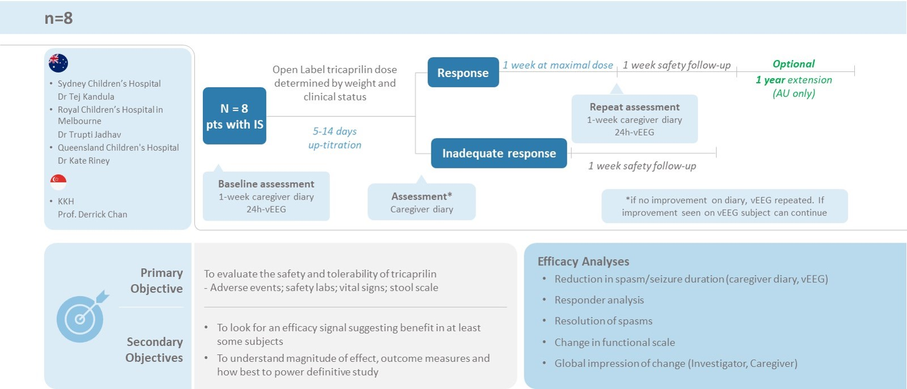
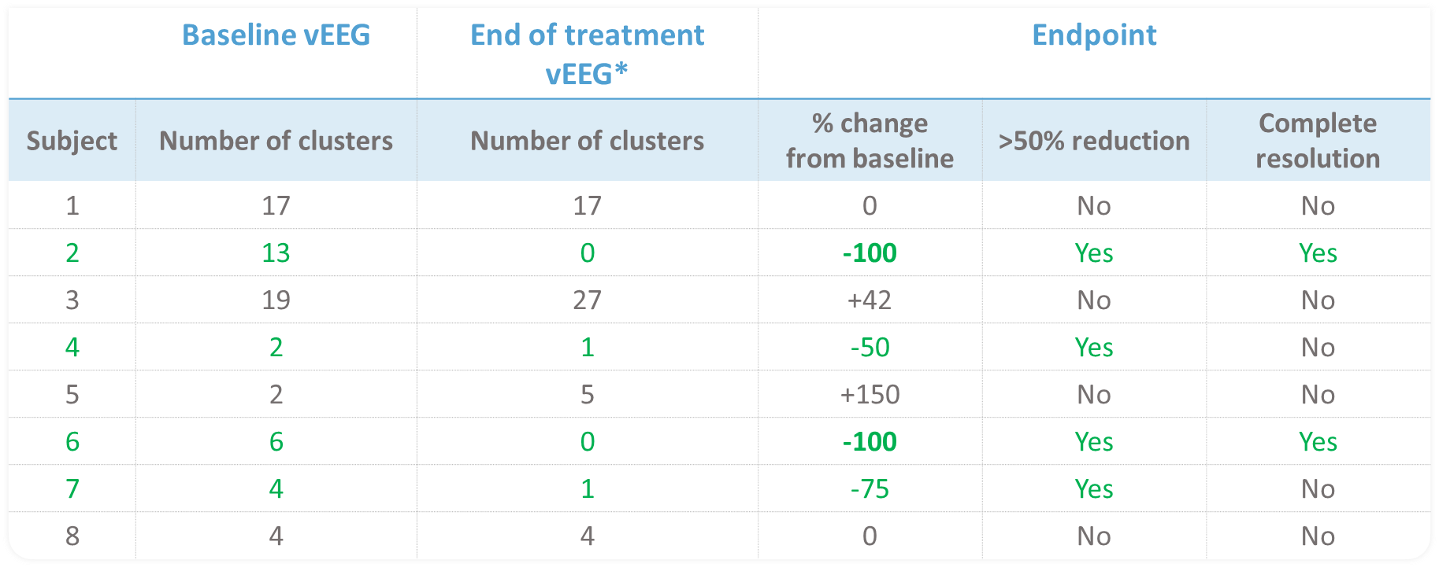
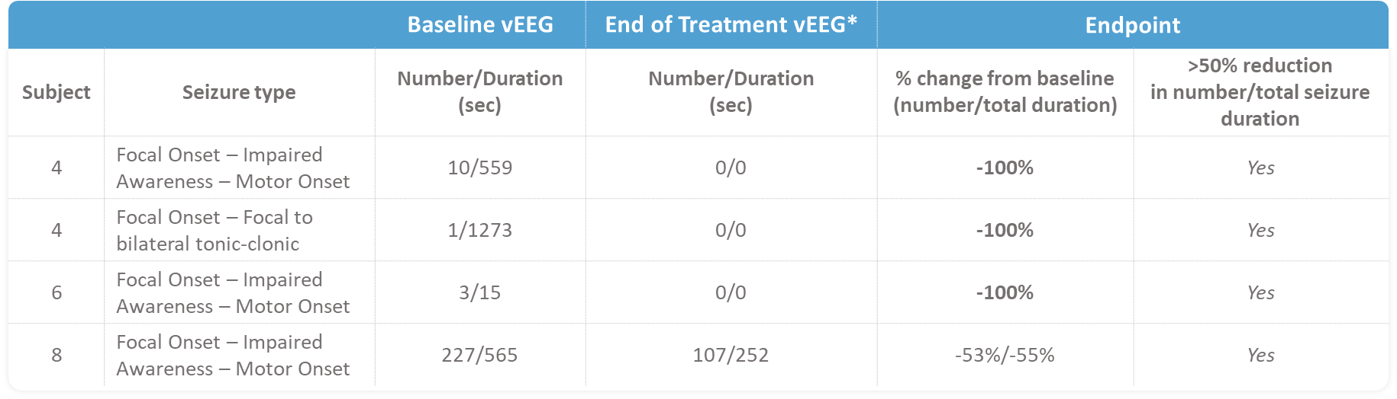
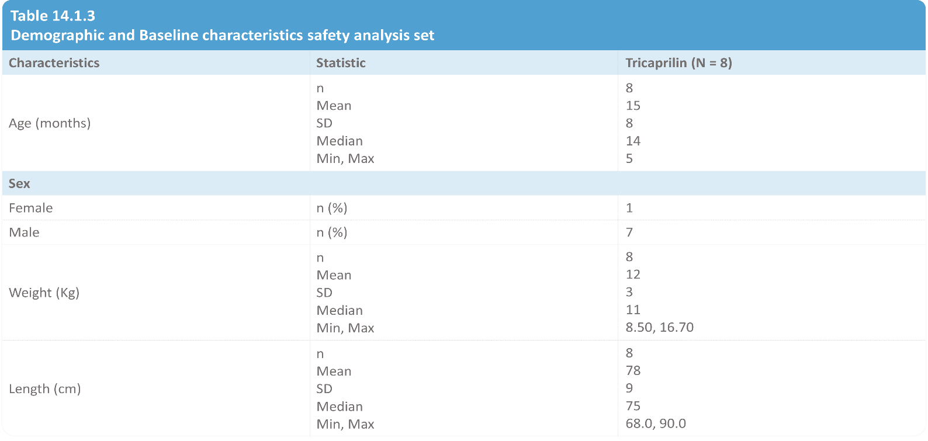
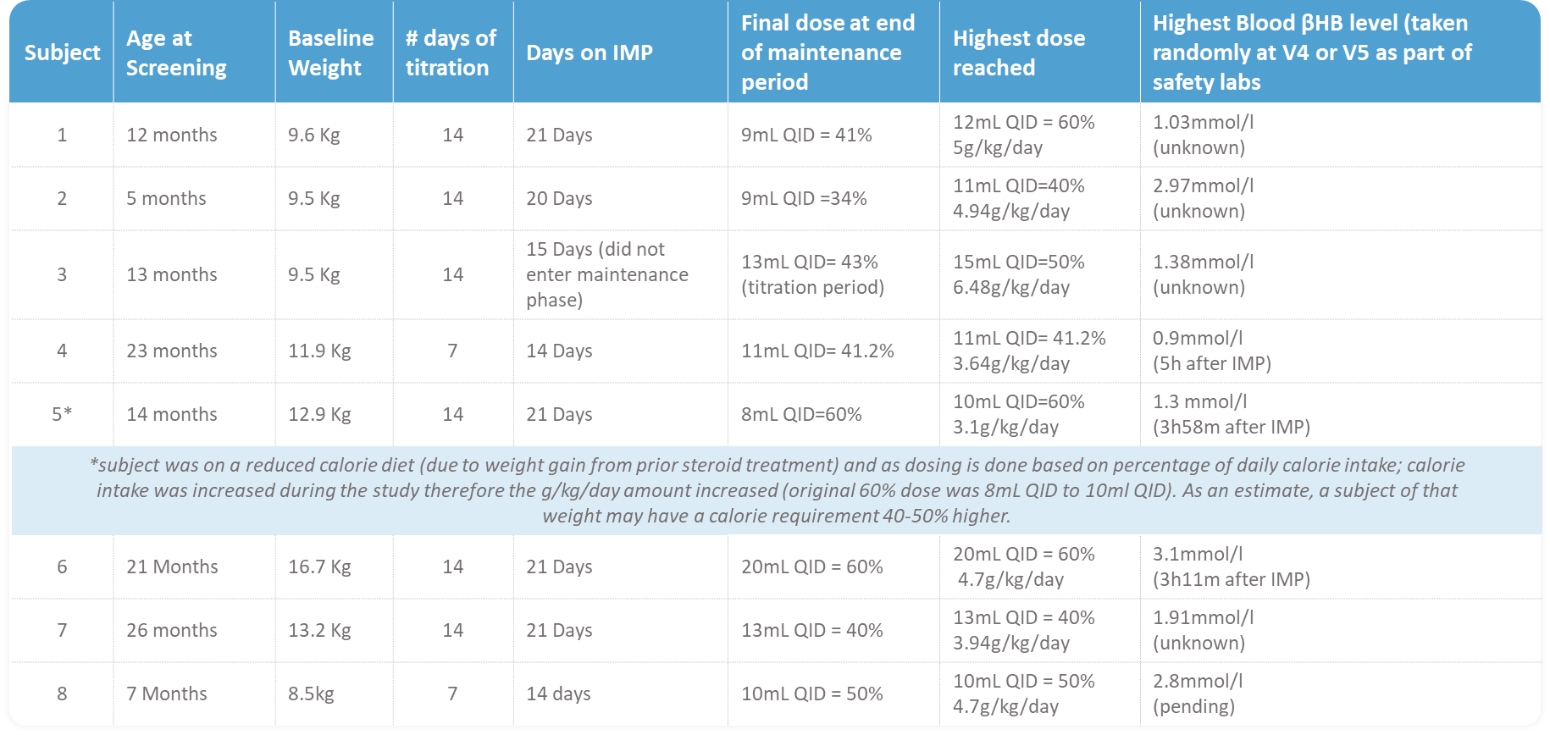
Tricaprilin, an Investigational Ketogenic Drug in Refractory Infantile Spasms
Marc Cantillon MD³, John A Lawson BMed Phd¹, Eric Kossoff MD², Nikki McIntyre MSc³, Samuel Henderson PhD³. Lilian Chow MMRD³
Affiliations: ¹Sydney Children’s Hospital; University of New South Wales, Sydney, Australia; ²Johns Hopkins Hospital, Baltimore, Maryland, US. ³Cerecin Australia Pty Ltd.
ABSTRACT
AC-21-24 STUDY DESIGN
RESULTS
CONCLUSIONS
Objective: A pilot study to evaluate safety and tolerability of drug Tricaprilin for treatment of drug-resistant Infantile Spasms (IS), a disorder characterized by epileptic spasms, developmental regression, and hypsarrhythmia. Ketogenic diets (KD) have been used in the management of multiple pediatric and adult epilepsies. Tricaprilin is an orally administered, liquid, investigational ketogenic agent with preclinical IS model efficacy. This study investigated use of Tricaprilin in IS, whilst allowing the continuation of the current source of nutrition.
Results: Overall the treatment was well tolerated with primarily GI adverse events. Two events were graded as severe, one bronchiolitis considered unrelated to treatment, and one aspiration because of feeding tube misplacement. There were no lab or other abnormalities, micronutrients are under evaluation Random sampling of blood β-hydroxybutyrate (BHB) levels indicates all 8 subjects were in ketosis by the end of the titration phase and in the maintenance phase. In 4 out of 8 subjects, efficacy on vEEG reduction in cluster number and duration of epileptic spasms was observed with caregiver diaries and clinician rating in the same direction.
Conclusion: Positive safety results and benefit observed in some subjects in this Phase 2a Tricaprilin study for the treatment of IS and warrant continued investigation.
Overall well-tolerated, with mild-moderate GI the most common of adverse effects
Tricaprilin led to ketosis in all infant subjects
4/8 infants had 50-75% improvement of seizure clusters on video EEG
2/8 infants had 100% improvement of seizure clusters on video EEG
Three infants had improvements in other
seizure types
Tricaprilin shows preliminary benefit for refractory infantile spasms, an extension phase is ongoing up to 12 months and a pivotal RCT is in preparation
Tricaprilin offers a novel ketogenic potential treatment, without KD nutrient restrictions
and burden
DURATION AND FREQUENCY
OF OTHER SEIZURE TYPES
DEMOGRAPHICS
REFERENCES
(3/3) had Up to 55% reduction in other seizure types
(2/3) had resolution of other seizure types
Stafstrom CE et al. Treatment of Infantile Spasms: Emerging Insights From Clinical and Basic Science Perspectives. Journal of Child Neurology. 2011;26(11):1411-1421.
Henderson ST, Vogel JL, et al. Study of the ketogenic agent AC-1202 in mild to moderate Alzheimer's disease: A randomized, double-blind, placebo-controlled, multicenter trial. Nutr Metab. 2009; 6(1): 31.
Martin-McGill KJ, Bresnahan R, Levy RG, Cooper PN. Ketogenic diets for drug-resistant epilepsy. Cochrane Database of Systematic Reviews 2020, Issue 6. Art. No.: CD001903. DOI: 10.1002/14651858.CD001903.pub5.
Kossoff E Efficacy of the Ketogenic Diet for Infantile Spasms Pediatrics (2002) 109 (5): 780–783.
SAFETY AND TOLERABILITY FINDINGS
2/8 (25%) subjects experienced severe TEAEs, 3/8 (38%) subjects experienced mild and moderate TEAEs respectively
Most common TEAEs are GI – 6/8 (75%) subjects
Commonest TEAE is vomiting – 4/8 (50%) subjects
Majority mild and moderate in intensity (95%)
Two events (5%) were graded as severe: 1 case of bronchiolitis (SAE), and 1 case of aspiration (SUSAR)
No lab, vital signs or other significant abnormalities, with micronutrients under evaluation
METHODS
TRICAPRILIN DOSE AND BHB LEVELS
Tricaprilin is emulsified with either milk (breast milk,
cow’s milk), formula, or food of a liquid consistency in
a blender prior to administration
Tricaprilin is administered 4 times a day for 3 weeks
Starting dose is 5% of total daily calories. Titration occurs over 5-14 days to a maximum dose of 60% of total daily calories as tolerated
No Ketogenic Diet restrictions
ACKNOWLEDGEMENTS/CONTACT
Cerecin thanks both the families and investigator teams for support in developing a potential new epilepsy treatment
clinical@cerecin.com

